Slide 1


SWIGGY DATA ANALYSIS
SUBMITTED BY:
PRINCE RAJ

Slide 2
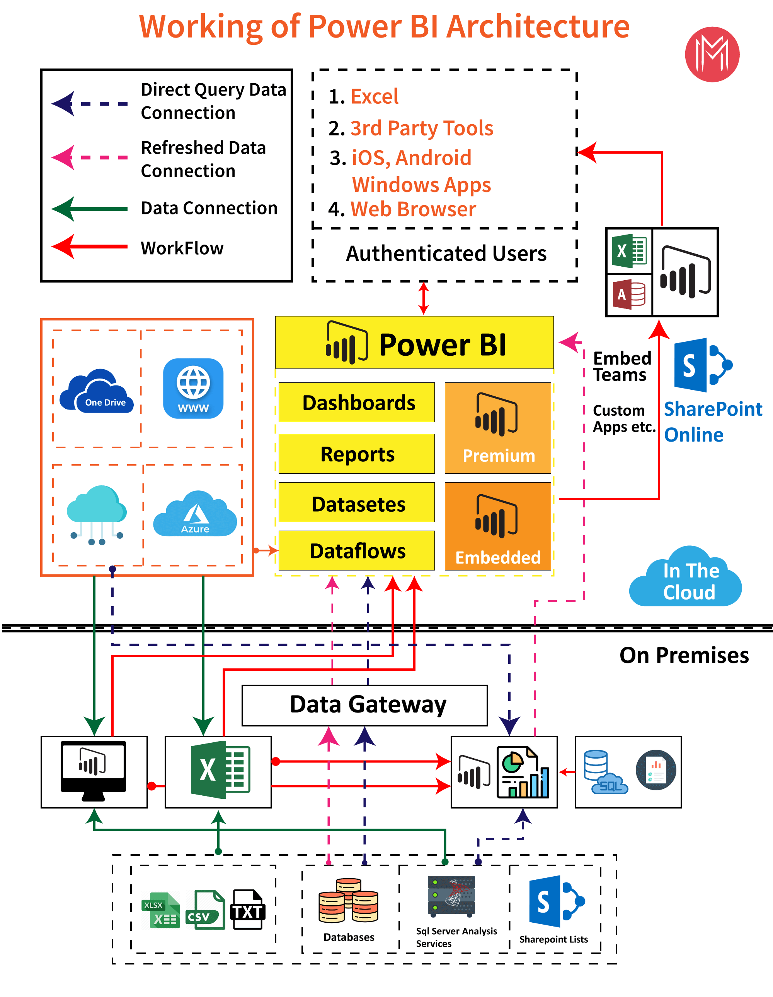
ARCHITECTURE

Slide 3
ETL OPERATIONS
Cleaning poorly formatted columns from the extracted raw data.
Skipping rows with Nan values.
Removing duplicated rows.
Changing the data types for necessary columns.

Slide 4
INSIGHTS

Slide 5
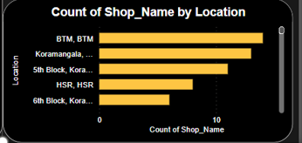

Slide 6
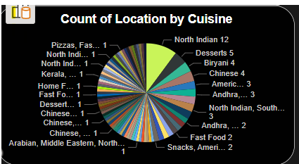

Slide 7
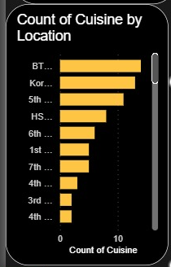

Slide 8
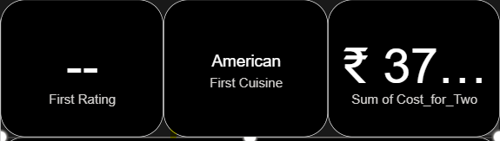

Slide 9
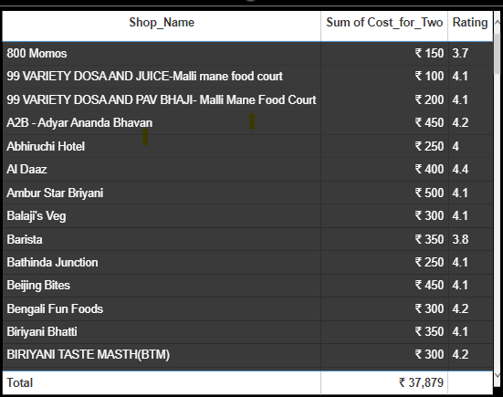

Slide 10
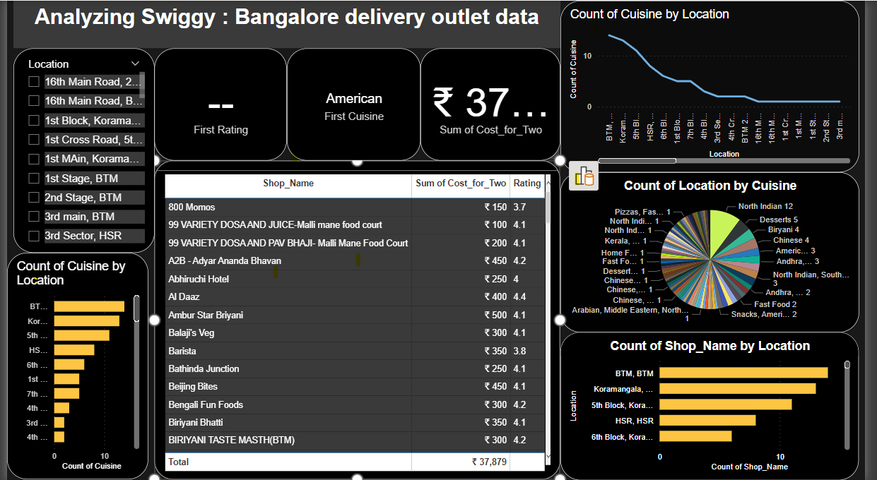
Final Dashboard

Slide 11
Q & A
What's the Source of the Data - Collected from Given Data Set
Which tools you are used in this entire project – Power Bi
How did you deploy the report - The report was deployed in my Power BI Public Server
What was the type of Data - Numerical and Categorical Values

Slide 12
THANK YOU

